Slide 1
TEXT MINING
Statistical NLP - Understanding content

Slide 2
EXAMPLE TASK
Can we train a classifier to recognize it from the signals in text?
Can we train a classifier to recognize whether the text is about White Wine or Red Wine?
Can we train a classifier to recognize whether the text is about Sauvignon Blanc or Riesling?
Can we train a classifier to recognize whether the review is good or bad?
"It's a dry white wine and the flavor is delicious. Great wine, fast service, what more could you ask for?"
“Aromas include tropical fruit, broom, brimstone and dried herb. The palate isn’t overly expressive, offering unripened apple, citrus and dried sage alongside brisk acidity.”
What is the object being described?
White Wine
Signals – acidity, citrus, apple

Slide 3
BUILDING A CLASSIFIER
D is a labelled collection of documents
d ϵ D
L is a set of pre-defined labels = {l₁, l₂, …, l_{n}}
Every document d is assigned a class label l ϵ L
Given a new document d – what label should be assigned to it?

Slide 4
Label - Riesling
This almost clear colored Auslese from Fritz Haag is Excellent! It opens with a musty wet stone bouquet with hints of lime and pear. On the palate, this wine is medium bodied, nicely balanced, smooth and silky. The flavor profile is a delicious pleasantly sweet mild lime and pineapple blend with wonderfully integrated acidity and hints of pear. The finish is nicely extended and lingers for a very long time. I would sip this gem on its own and savory every moment.
Label - Riesling
This almost clear colored Riesling from Fritz Haag is very impressive. It opens with a yellow grapefruit and mild petrol bouquet with hints of sweet fruit lingering in the background. On the palate, this wine is light bodied, pleasantly sweet and silky. The flavor profile is a tasty mild lime and ginger blend with nicely integrated minerality. I also detected hints of pineapple and a touch of white peach in the background. The finish is remains delicately sweet and drifts away nicely. This Riesling its terrific and will be a quaffer. Swirl it at first and enjoy with grilled scallops
Label – Pinot Gris
This golden straw colored Pinot Gris has an inviting citrus fruit bouquet that includes vanilla and light wet stone. I also detected hints of peaches. This light bodied wine from Monterey is smooth with a lemon, lime, citrus and melon palate with a dash of green apple. I enjoyed the vibrant and balanced acidity. The finish was slightly dry and faded away nicely. This is an easy-going wine and will be a crowd pleaser.
Label – Pinot Gris
This almost clear colored Pinot Gris from Navarro opens with a fragrant tangerine and lime bouquet. On the palate, this wine is medium bodied, balanced and mouthwatering. The flavor profile is tasty mineral infused green apple with notes of white pepper and quince. The finish is rather dry and refreshing. This Pinot Gris is food friendly and would pair well with linguini with clams and garlic butter sauce.
Description of Wine

Slide 5
Label = ?
Nothing like starting out with a bang on a first release affordable wine from Elk Cove Vineyards! This light bodied wine opens with an inviting fruit and floral bouquet including light pineapple, pear and light rose petal. I also detected hints of guava. The color is basically clear with a slight straw tint. The palate is fresh, slightly dry, smooth, crisp and includes flavors of pineapples, apricots, and hints of guava. This Willamette Valley offering is very versatile and food friendly with nice texture, acidity and balance. It finishes with a nice mouth coating dry pink grapefruit that fades away nicely.

Slide 6
Features To be Used
Words
How - Vector - Space representation of documents

Slide 7
DOCUMENT REPRESENTATION - BINARY
Construct Term – document matrix – appended by labels
Construct Term-Class Matrix
 | This | Clear | Straw | Lime | Sweet | Dry | t7 | t8 | t9 | t10 | Label
d1 | 1 | 1 | 0 | 1 | 1 | 0 | 0 | 0 | 0 | 0 | l1
d2 | 1 | 1 | 0 | 1 | 1 | 0 | 1 | 1 | 0 | 0 | l1
d3 | 1 | 0 | 1 | 1 | 0 | 1 | 0 | 0 | 0 | 0 | l2
d4 | 1 | 1 | 0 | 1 | 0 | 1 | 1 | 0 | 0 | 1 | l2
 | t1 | t2 | t3 | t4 | t5 | t6 | t7 | t8 | t9 | t10
l1 | 2 | 2 | 0 | 2 | 2 | 0
l2 | 2 | 1 | 1 | 2 | 0 | 2

Slide 8
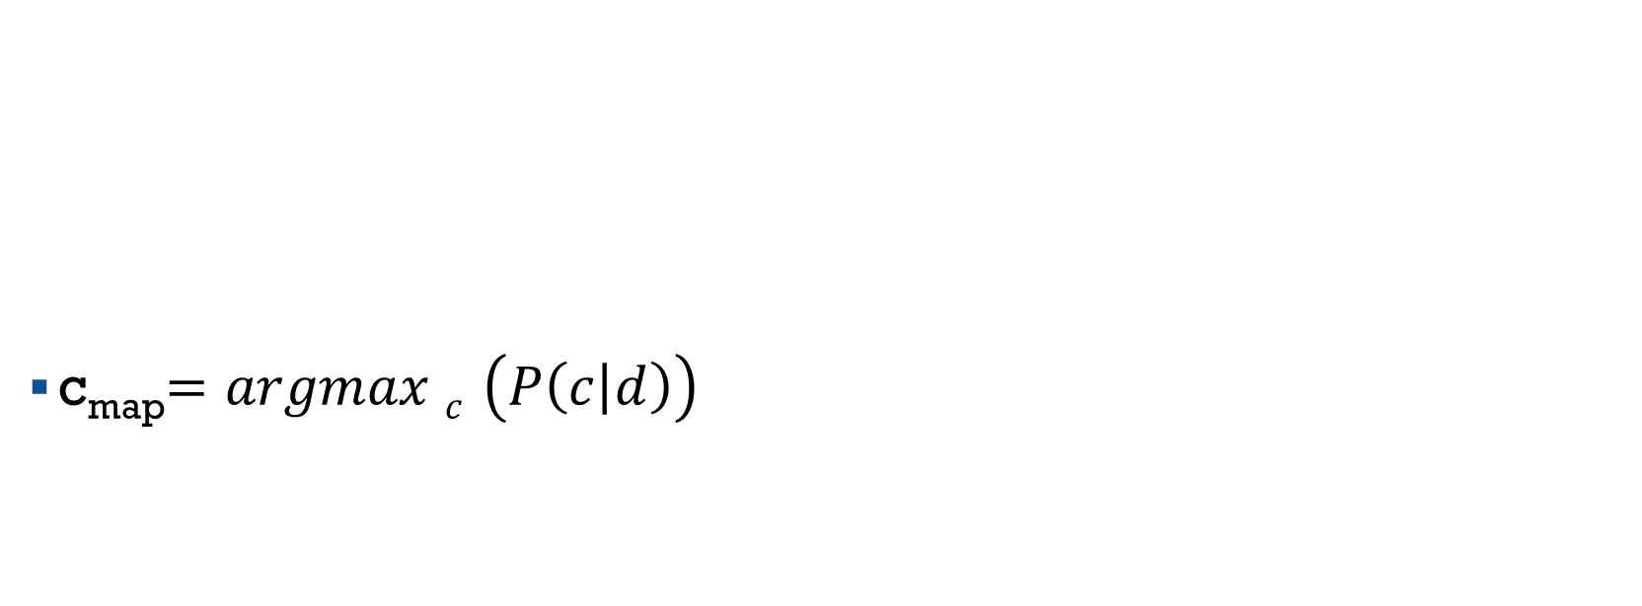
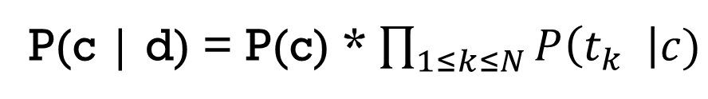
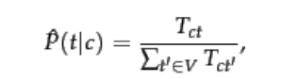
PROBABILISTIC TEXT CLASSIFICATION
Given a new document d – extract terms t_{k} ϵ d

Slide 9

How Words Work
Nothing like starting out with a bang on a first release affordable wine from Elk Cove Vineyards! This light bodied wine opens with an inviting fruit and floral bouquet including light pineapple, pear and light rose petal. I also detected hints of guava. The color is basically clear with a slight straw tint. The palate is fresh, slightly dry, smooth, crisp and includes flavors of pineapples, apricots, and hints of guava. This Willamette Valley offering is very versatile and food friendly with nice texture, acidity and balance. It finishes with a nice mouth coating dry pink grapefruit that fades away nicely.
sweet – missing
dry - present
Straw - present
label = Pinot Gris

Slide 10
K-NEAREST NEIGHBOURS
Construct Term-document Matrix for documents using TF-IDF weights
For a new document d – find it’s k nearest neighbours using Cosine Similarity
Assign label that is dominant – for majority of documents within k neighbours
Nothing like starting out with a bang on a first release affordable wine from Elk Cove Vineyards! This light bodied wine opens with an inviting fruit and floral bouquet including light pineapple, pear and light rose petal. I also detected hints of guava. The color is basically clear with a slight straw tint. The palate is fresh, slightly dry, smooth, crisp and includes flavors of pineapples, apricots, and hints of guava. This Willamette Valley offering is very versatile and food friendly with nice texture, acidity and balance. It finishes with a nice mouth coating dry pink grapefruit that fades away nicely.
Label l₁
d1
d2
Label l₂
d3
d4
D5
K = 5
5 closest Neighbors

Slide 11
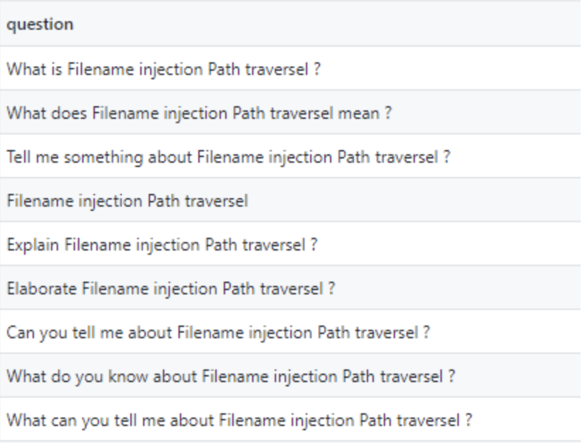
TEXT CLASSIFICATION APPLICATIONS
Sentiment analysis
Spam detection
Intent detection
Intent1
Intent2
What is t - test?
What does t -test mean?
Tell me what you know about t-test
Please Elaborate on what is t-test
What can you tell me about t-test
Given a new question - does it belong to Intent1 / Intent2 / None

Slide 12
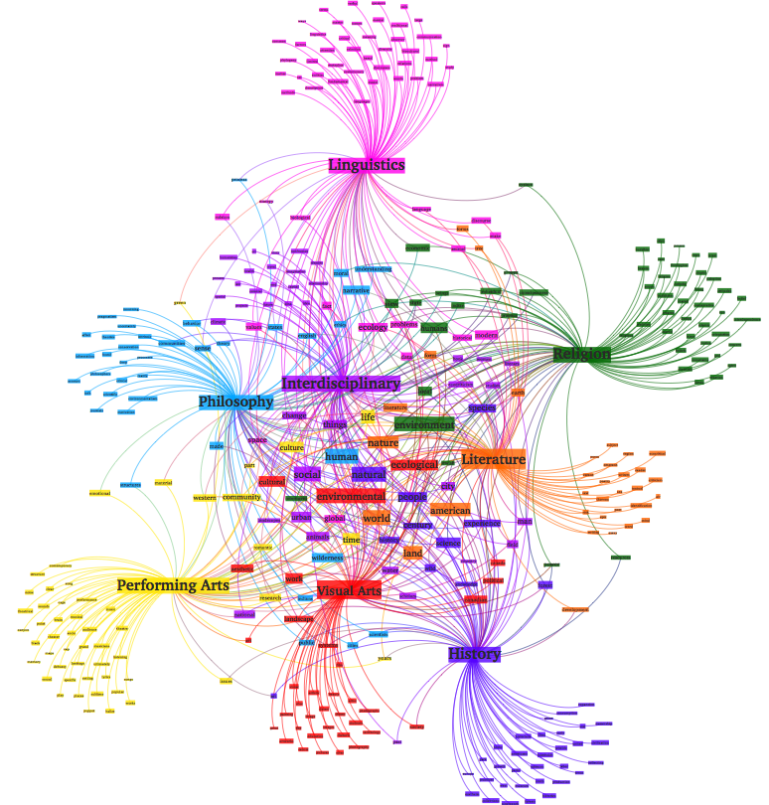

Unsupervised Analysis
How to group similar documents
How to extract Topics
How to arrange documents topically

Slide 13
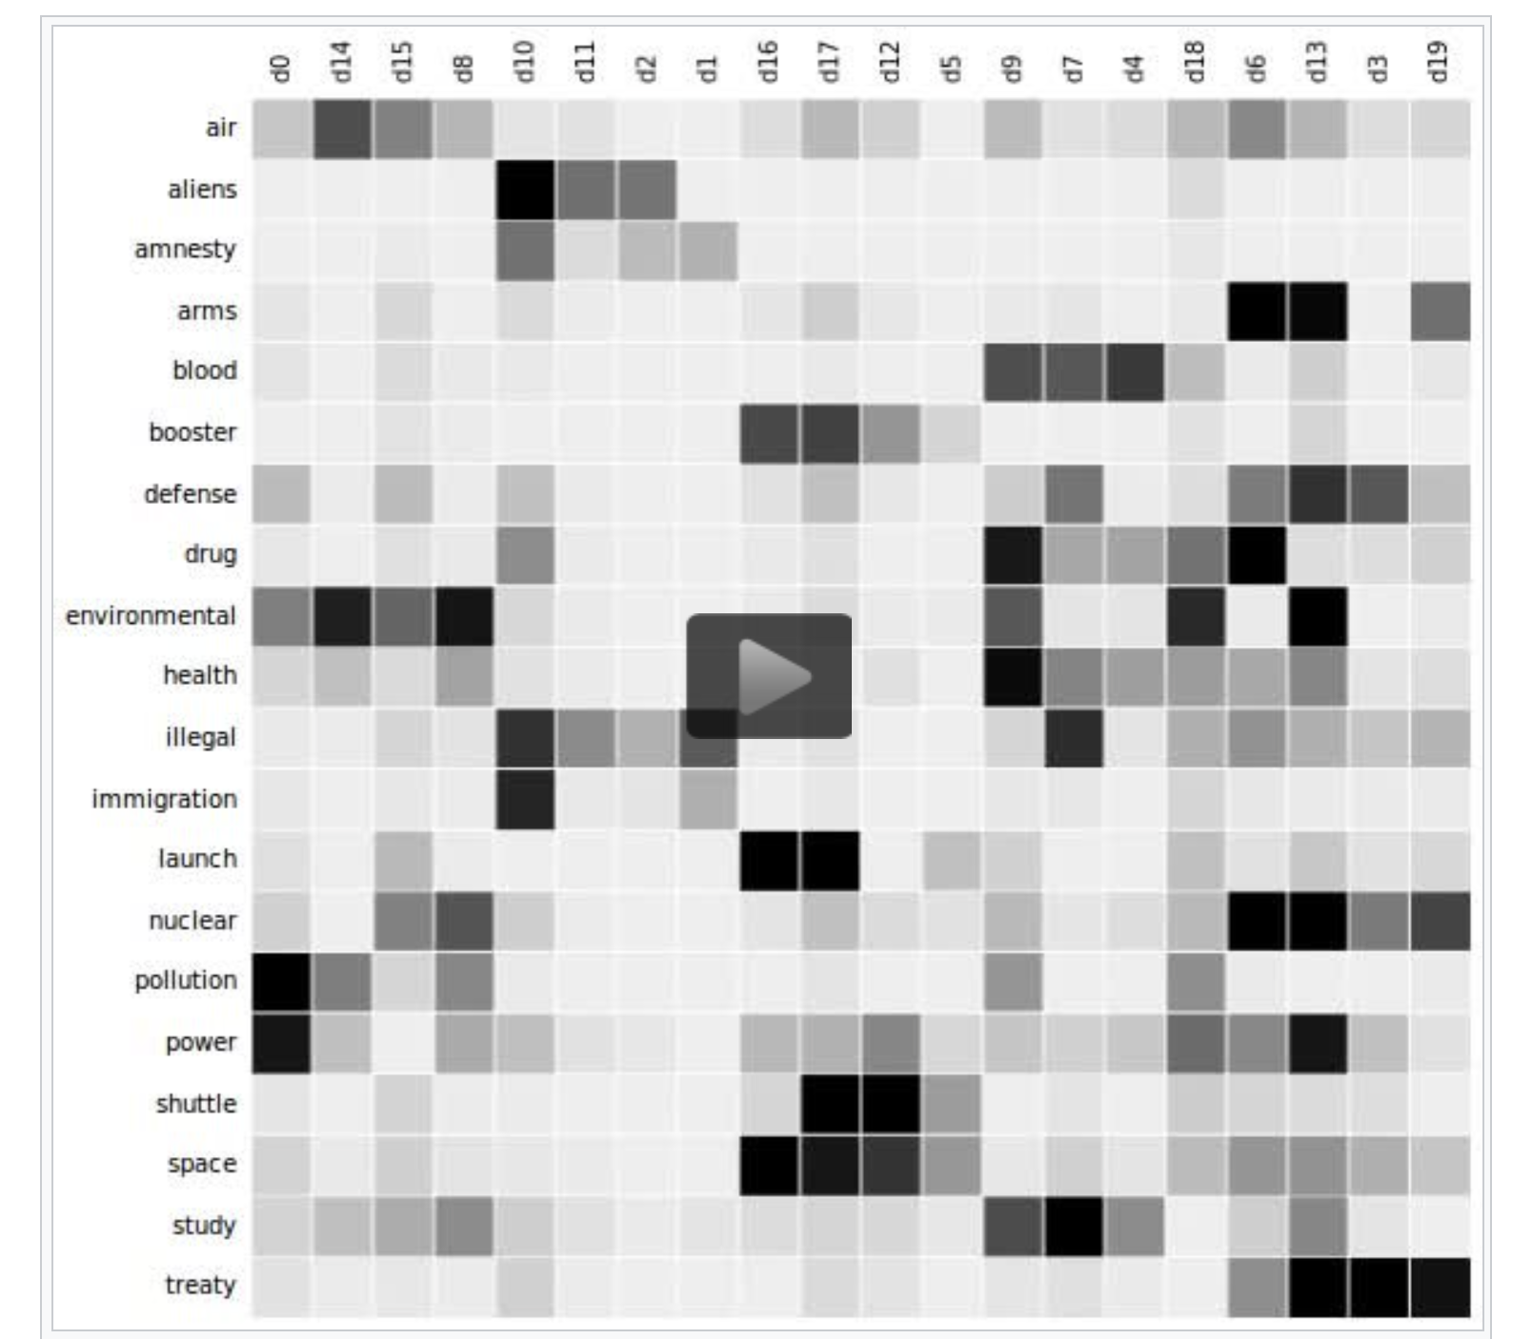
Clustering

Slide 14
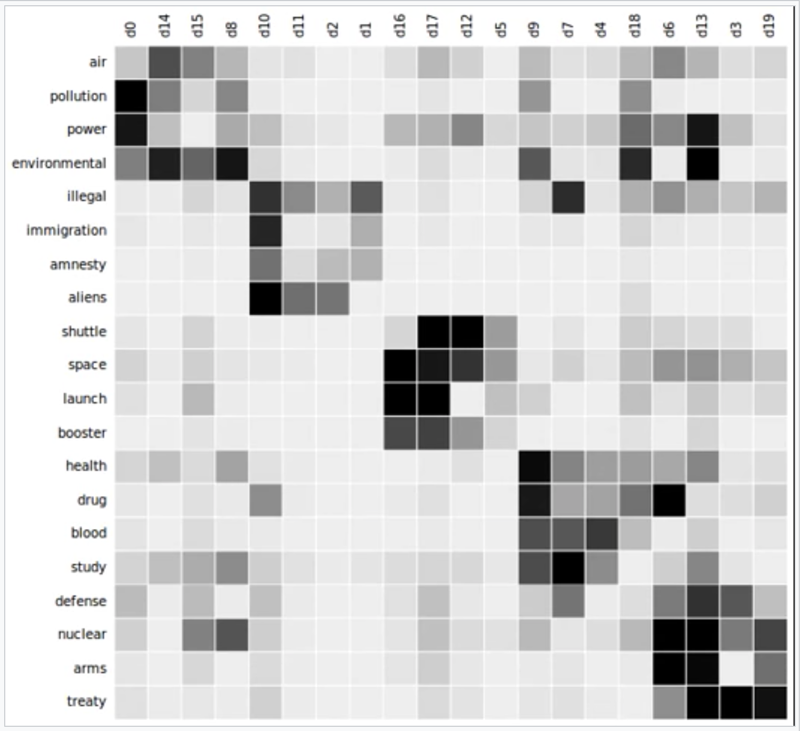
Grouping Similar Documents
Using words as features and any known Clustering algorithm
K medoids
Non-negative factorization
Entropy based
LSI based methods
Grouping by Similar Terms
Doesn’t say what each cluster is about
https://jlu.myweb.cs.uwindsor.ca/8380/text-cluster.pdf

Slide 15
Ambiguity - polysemy
I can’t bear this stress any more ------The bear lost its life in bushfire
She rose to the occasion ----------- He gave a rose to her
The bank is a nice place for an evening stroll --------The bank has no money.
I am hungry -------------- I am hungry for knowledge
I love baking cakes --------- an act or an adjective?
I liked the title music of the movie – this story has no title

Slide 16
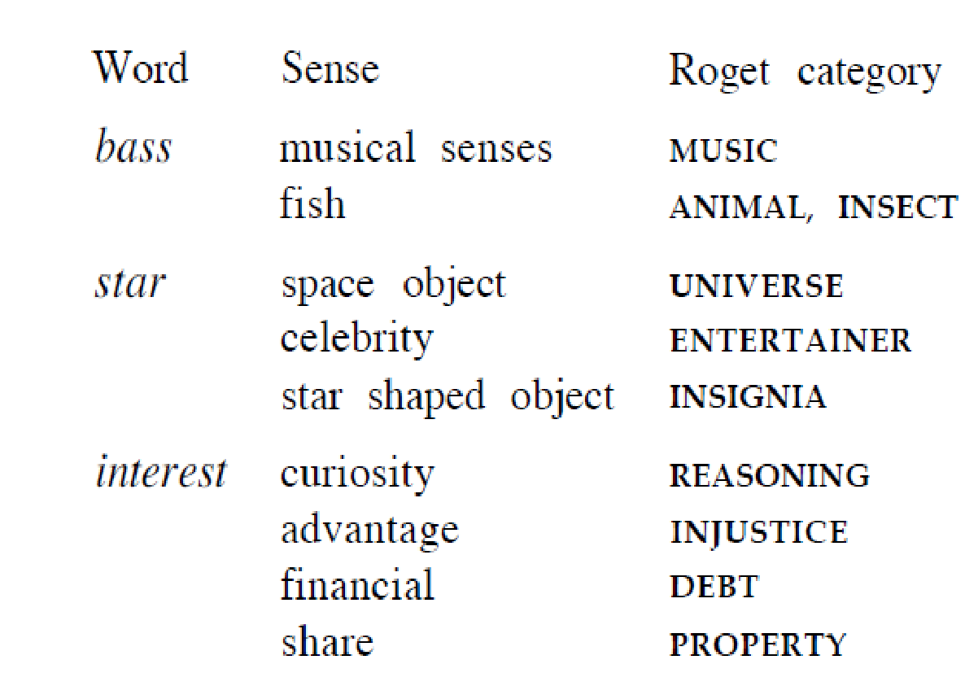
WordNet - an attempt to create a dictionary of senses
https://wordnet.princeton.edu/

Slide 17
Word Sense Disambiguation and Context
Phenergan is used,
To treat allergic conditions such as hay fever or rashes (like nettle rash or hives), To treat travel sickness
To treat adults with sleeping difficulty (insomnia) (short term use), As a sedative for children aged 2 years and above (short term use)
Diphenhydramine is used to relieve red, irritated, itchy, watery eyes; sneezing; and runny nose caused by hay fever, allergies, or the common cold. Diphenhydramine is also used to relieve cough caused by minor throat or airway irritation.
I am on Prevacid 30 mg twice a day. You didn't mention your Prilosec dose. If it is at 20mg twice a day, you can go up to 40mg twice a day. If that doesn't work you can add a variety of drugs, such as zantac, pepcid, or carafate. I have been on 800mg Zantac a day, and 10cc carafate four times a day. After that, a propulsid such as reglan can be added. I was on Reglan four times a day at 10mg. After that sometimes an antiemetic can be added. I have used compazine and phenergan in this class of drugs. Occasionally after that surgery is persued, though some doctors, such as mine, will flat out not do the surgery, since there have been studies that show less than 10% of the people who have it done are still off drugs a year later, the recovery is tough, and there is evidence that if drugs don't work, surgery won't either.
Ascoril helps treat chronic bronchitis, in which the airways within the lungs are swollen, reddened, and inflamed. Doctors also prescribe it to relieve asthma attacks caused due to airway blockage and spasms. Ascoril LS is also used to treat chronic respiratory problems, congestion, lung congestion, and sinusitis.
Antihistamines, like benadryl, should not be taken with alcohol, because it will cause increased drowsiness.

Slide 18
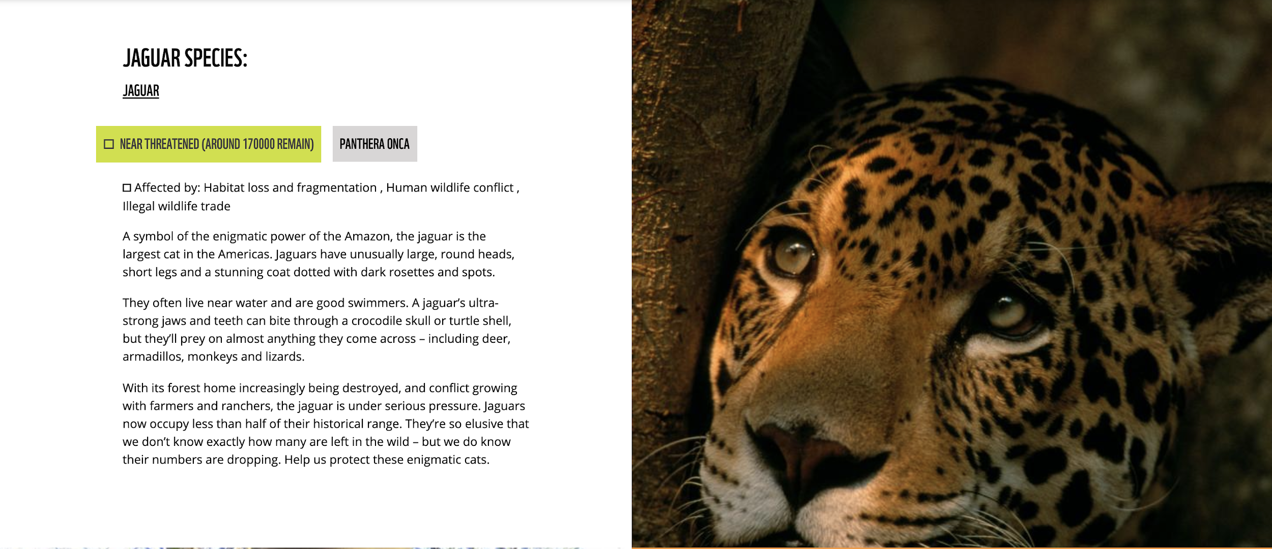
Example
Doesn’t contain - animal, food

Slide 19
Latent Semantic Analysis
The Term - Document matrix is large and sparse
Latent Semantic Analysis finds a low-rank approximation] to the term-document matrix
The original term-document matrix is too large for the computing resources - the approximated low rank matrix is interpreted as an approximation
The original term-document matrix is presumed noisy: for example, anecdotal instances of terms are to be eliminated - in that sense the approximated matrix is interpreted as a de-noisified matrix (a better matrix than the original)
The original term-document matrix is presumed overly sparse relative to the "true" term-document matrix - the original matrix lists only the words actually in each document, whereas we might be interested in all words related to each document — and that can be a much larger set due to synonymy, meronymy, holonymy etc.

Slide 20
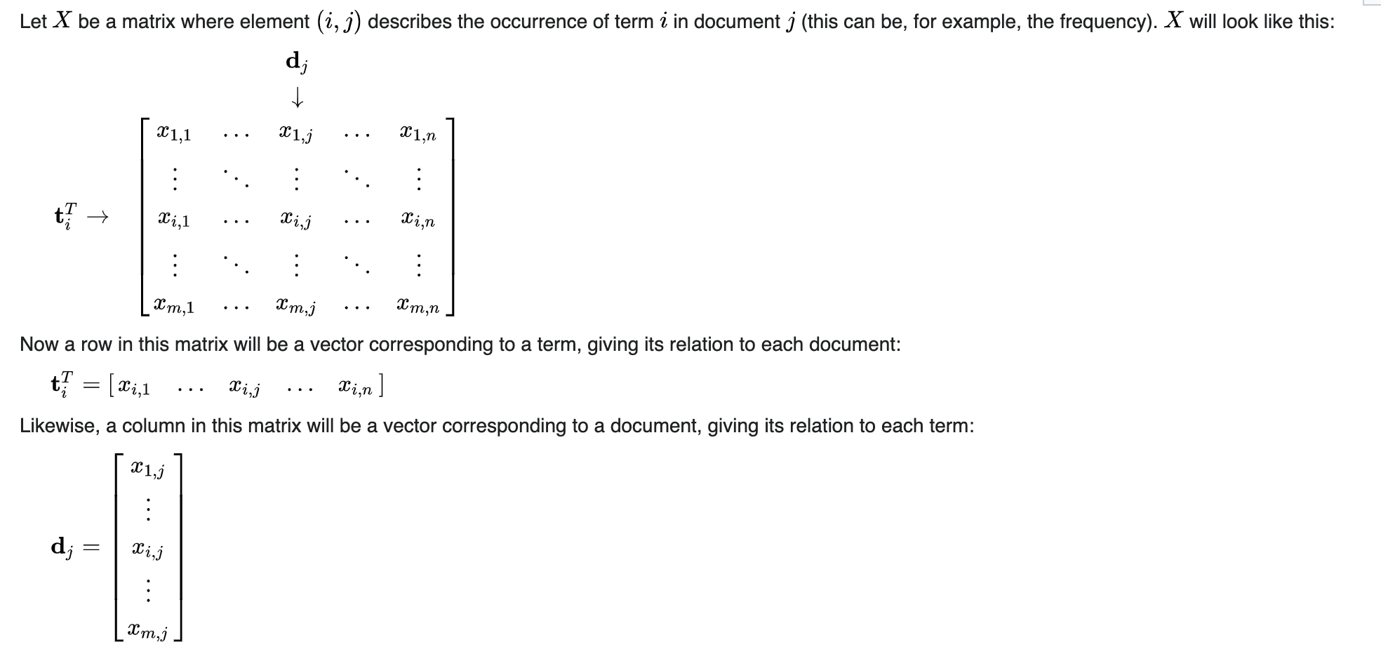
TF - IDF / Frequency Matrix

Slide 21
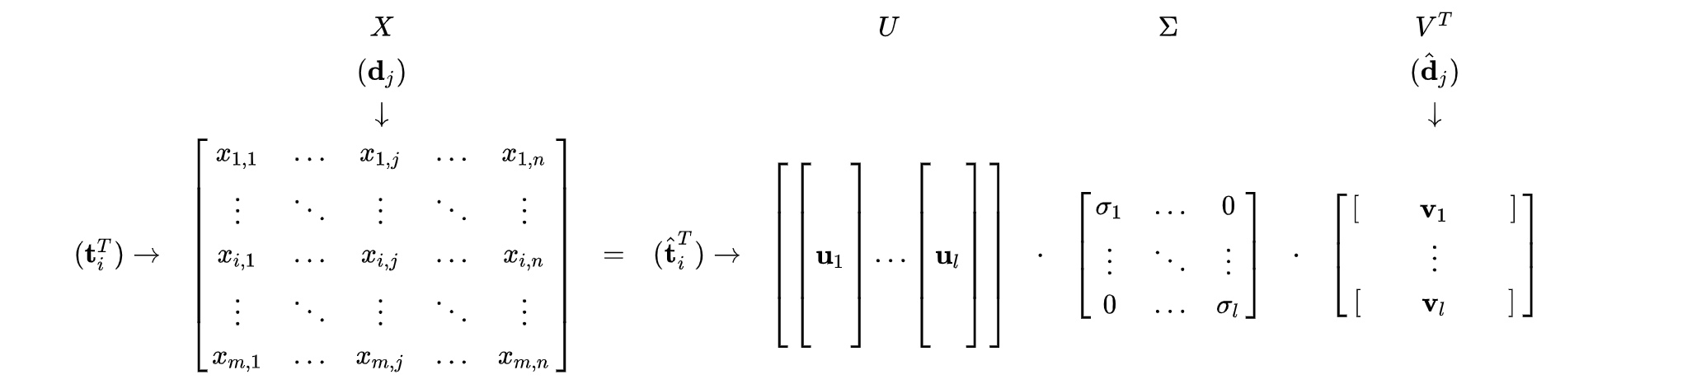
Decomposition
X = U𝚺V^{T}
Left Singular Vectors Singular Values Right Singular Vectors

Slide 22
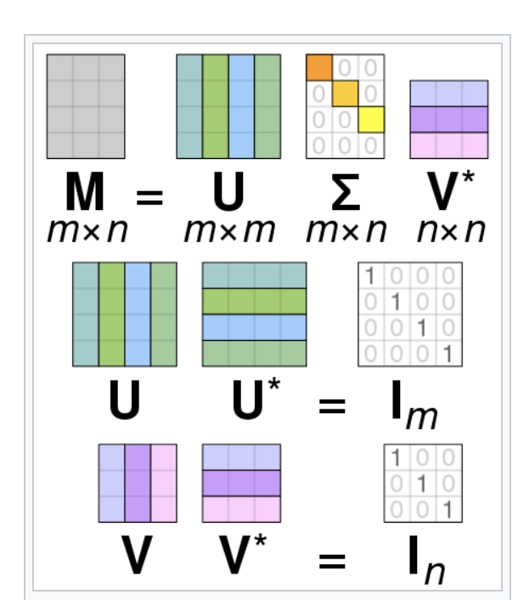
Visualization

Slide 23
Reconstruction
An approximation can be obtained using the k largest singular values and their corresponding left and right singular vectors
This approximation has a minimal error - and more importantly the term and document vectors can now be treated as "semantic space"
The row "term" vector t^_{i}^{T} has k entries mapping it to a lower-dimensional space - not a comprehensible physical space - linear combinations of words
{(car), (truck), (flower)} --> {(1.3452 * car + 0.2828 * truck), (flower)}
The "document" vector d_{j} is an approximation in this lower-dimensional space
Identifies synonyms - merge dimensions
Mitigates polysemy - since components of polysemous words that point in the "right" direction are added to the components of words that share a similar meaning - Conversely, components that point in other directions tend to either simply cancel out, or, at worst, to be smaller than components in the directions corresponding to the intended sense.

Slide 24
Semantic Analysis
X_{k} = U_{k}𝚺_{k}V_{k}^{T}
It is now possible to see how similar documents j and q are by comparing their representations in semantic spare - Cosine similarity between 𝚺_{k}d_{j} and 𝚺_{k}d_{q}
Comparing terms i and p by comparing the vectors 𝚺_{k}t_{i}^{T} and 𝚺_{k}t_{p}^{T}
Documents and term vector representations can be clustered using traditional clustering algorithms like k-means using cosine similarity measures
Given a query, it can be viewed as a mini document, and compared with all documents in repository

Slide 25
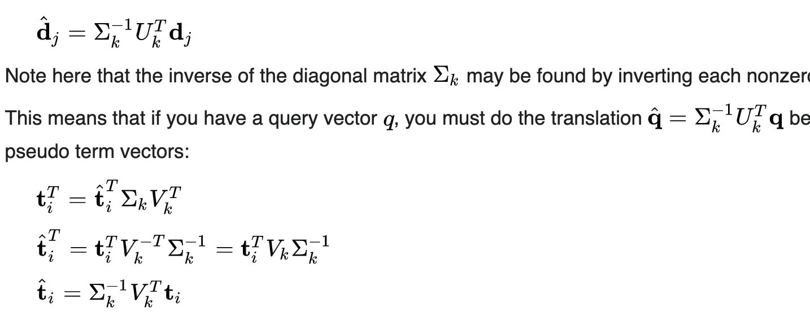
Information retrieval
Document -
Query -
Drawback
When adding new searchable documents - adding new terms to vocabulary is not possible
These terms will have no impact on the global weights and learned correlations derived from the original collection of text
However, the computed vectors for the new text are still very relevant for similarity comparisons with all other document vectors.

Slide 26
Topic Modeling using Latent Dirichlet Allocation
Each document is modeled as a multinomial distribution of topics
Each topic is modeled as a multinomial distribution of words
LDA assumes that the every chunk of text we feed into it will contain words that are somehow related
It also assumes documents are produced from a mixture of topics - those topics then generate words based on their probability distribution.

Slide 27
Covid-19 pandemic has been a disaster for millions of us. Imagine, though, how bad things would be if in the midst of this pandemic we were also hit by one of the deadliest storms in recorded history with wind speeds up to 190km/h and a storm surge of more than 5 meters high.
You wouldn’t need to imagine that if you were a resident of eastern India on May 20 because this is precisely what happened when Cyclone Amphan came barreling down from the Bay of Bengal. It was among the deadliest cyclones in the region in a century, leaving nearly 90 people dead and more than 10 million homeless.
Amphan originated as a low-pressure area around 300km east of Colombo, Sri Lanka. Moving northeastward, the cyclone left its trail in Sri Lanka, India, Bangladesh and Bhutan. West Bengal, the epicenter of the cyclone’s landfall, suffered the worst damage. While a detailed report on the total damage made by Amphan is yet to be published, an initial investigation estimates nearly $13 billion in damages to the state.
Amphan affected nearly 70% of the people in West Bengal, but the Sundarbans, a UNESCO World Heritage site, faced the most catastrophic destruction. The Sundarbans is a cluster of low-lying islands in the Bay of Bengal and is the largest mangrove forest in the world.
This is the land of Bon Bibi and Dokkhin Rai. Bon Bibi, or the Lady of the Forest, personifies the mangroves while Dokkhin Rai, her brother in local mythology, is the fearsome Bengal tiger. Most of the locals eke out a living appeasing the two.
Unfortunately for them, a third deadly force lies at their footstep, the heaving Bay of Bengal, one of the most agitated water body on the planet. Time and again it has sent horrible destruction hurtling down over the people of Sundarbans in the form of severe cyclonic storms. Amphan, too, brought grave misfortune to most of the four million residents of the Sundarbans.
One was Amina Bibi, a local woman in Kalikapur, who was notified by district officials ahead of the storm to move to the nearest school building on the day of the storm. “We never saw something like this before; everything is finished now! What are we supposed to do now! We don’t have our land left! What will we eat from tomorrow!” she lamented.
Khurshid Chowdhury from Gosaba was another victim. He had promised his grandson that he would buy him a boat se he could join in their family business of fishing. His family owns only a small of land for cultivating rice, but that land is now under 2 meters of seawater and is currently unusable for agriculture.
The Sundarbans is one of the least developed regions in West Bengal, inhabited by some of the most impoverished communities in India. Farming and fishing are the two means of livelihood here. The average elevation of the Sundarbans is 2 meters above mean sea level. This puts the area under threat from inundation and wetland loss.
Soil erosion and rising sea level have forced many locals to relocate in every 20 to 25 years for the last few decades. In addition to this, these climate refugees are suffering from an increase in soil salinity and damage to their farmlands after every flooding incident. A cyclone like Amphan pushes the resilience of the community further to the edge, leaving the lives, homes and resources of thousands of people at risk.

Slide 28
Social Media - content
Subreddit Posts - identify markers of depression
r/depression - 108908 posts
r/mentalhealth - 30980 posts
Mental Health - 139888 posts
Study 12205

Slide 29
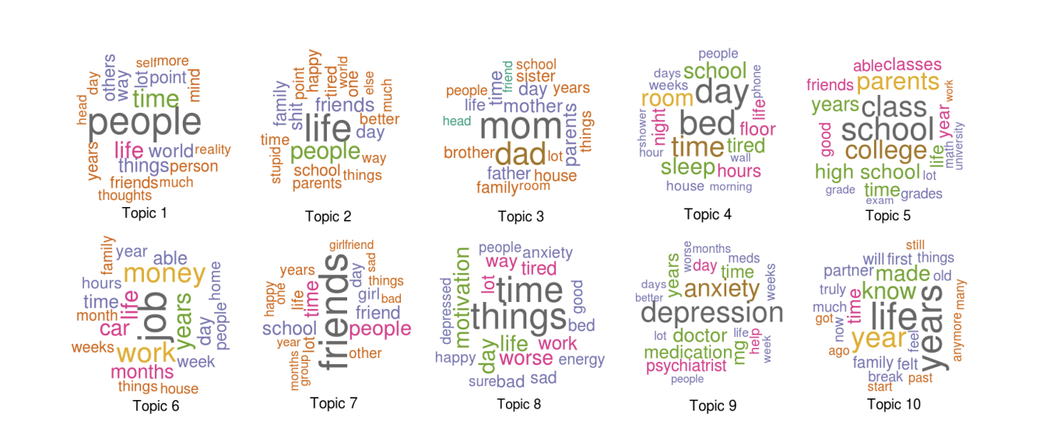
Studying Pandemic-time social media Posts - an application of Topic Analysis
What were people talking about?

Slide 30
How LDA works
LDA is a generative model
It starts by assuming that each document is generated as a certain distribution of topics
Each topic then generates words based on the probability distributions
Then it works backward and tries to figure out what topics would create those documents
Uses two hyper-parameters
𝜶 (Alpha) - controls the similarity of documents - a low value represents documents as a mixture of few topics, while a high value will output document representations of more topics -- making all the documents appear more similar to each other
𝝱 (Beta) - Beta controls topic similarity. A low value will represent topics as more distinct by making fewer, more unique words belong to each topic. A high value will have the opposite effect, resulting in topics containing more words in common.

Slide 31
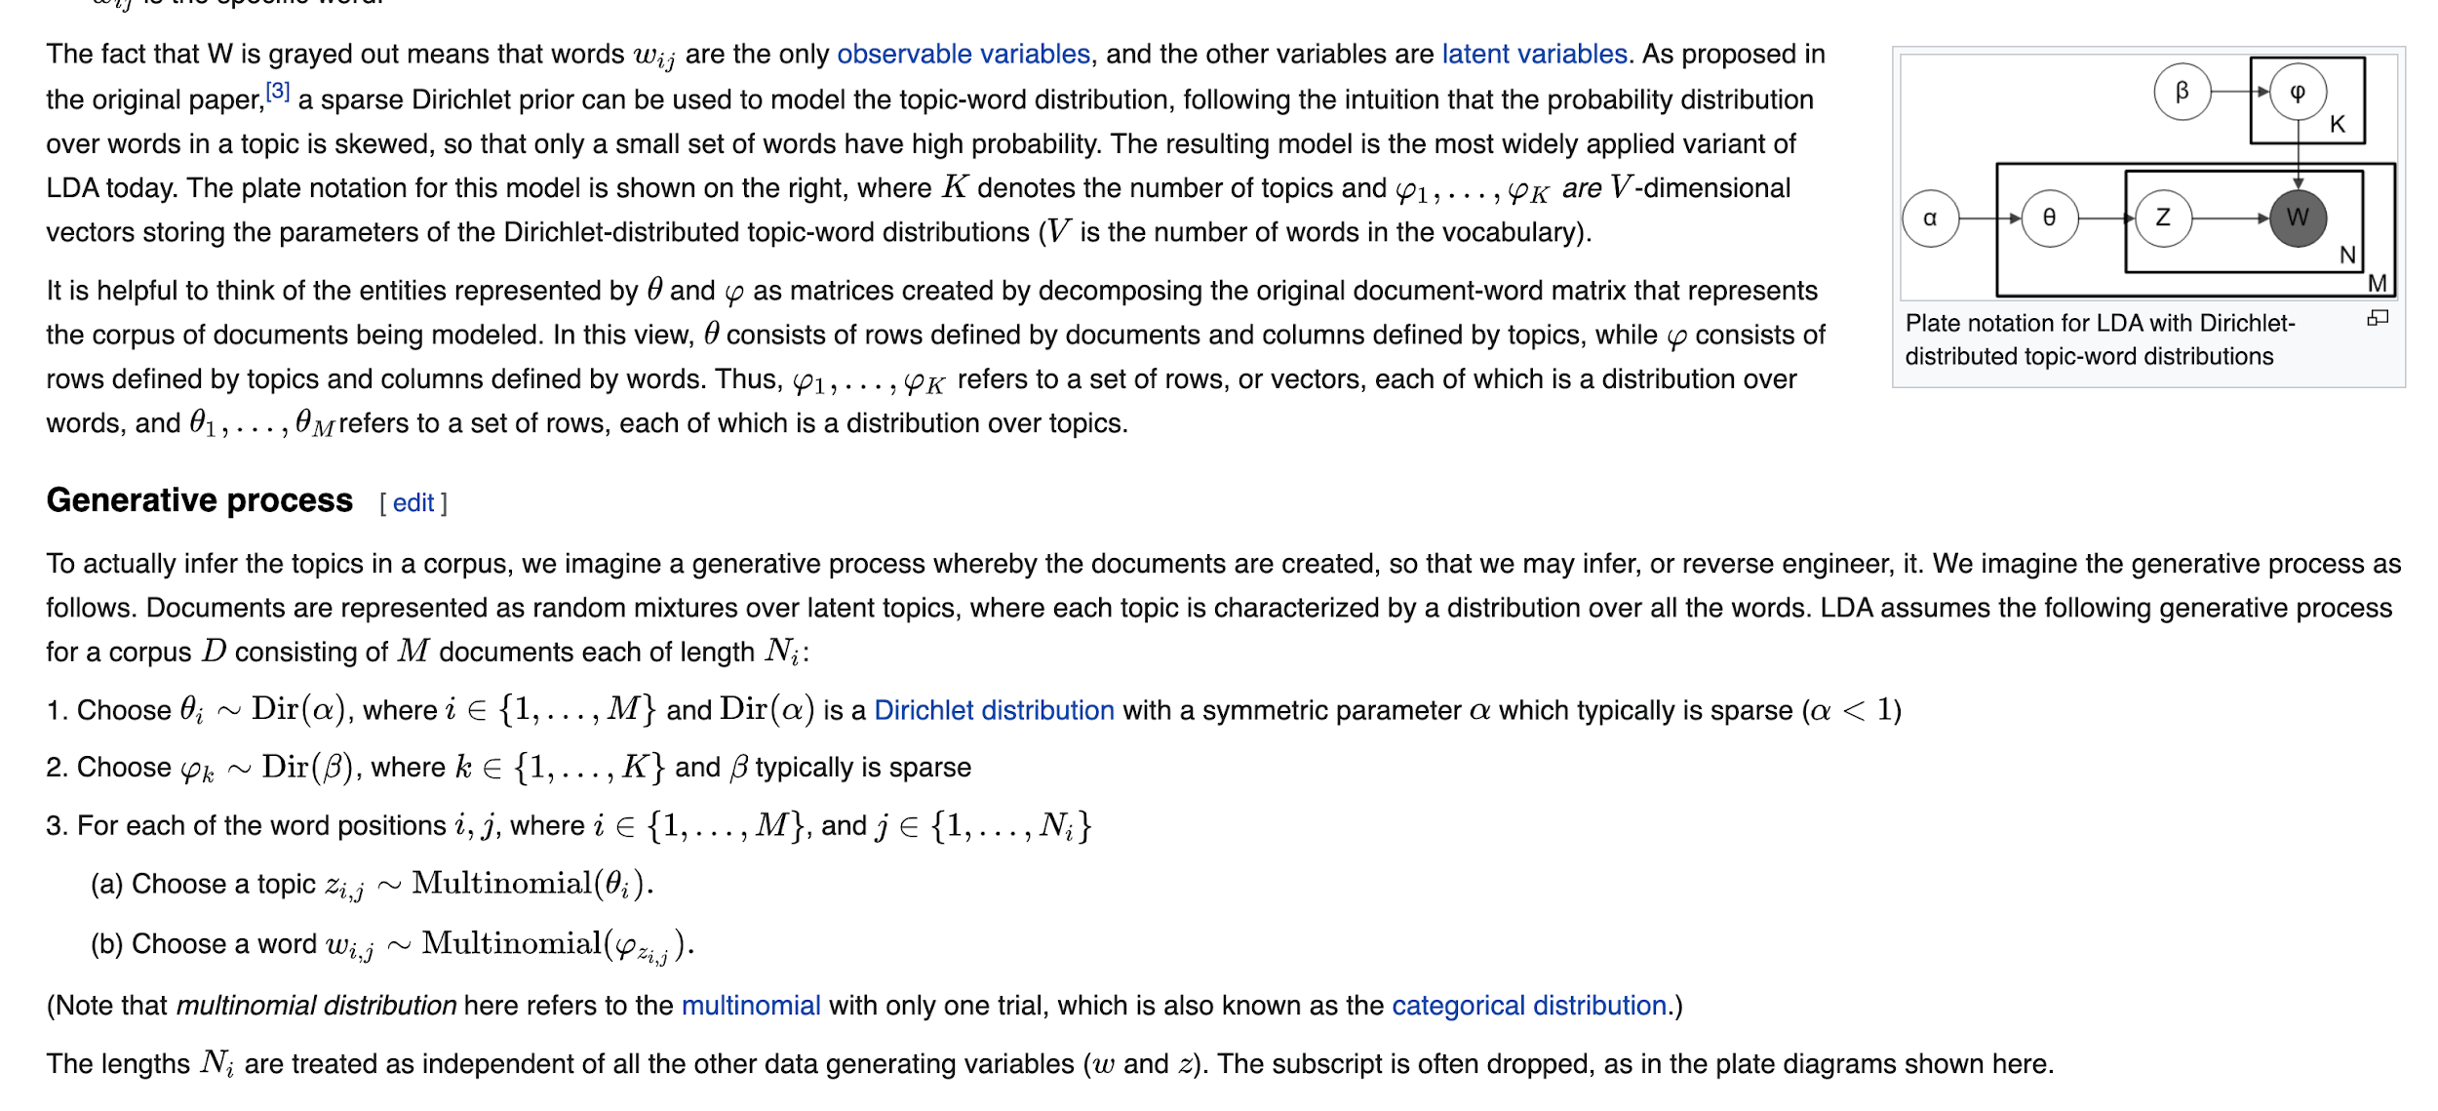
LDA is a form of unsupervised learning that reverse-engineers the process of document generation
Assume there are k topics across all of the documents
Distribute these k topics across document m (this distribution is known as α and can be symmetric or asymmetric, more on this later) by assigning each word a topic
For each word w in document m, assume its topic is wrong but every other word is assigned the correct topic.
Probabilistically assign word w a topic based on two things: - what topics are in document m - how many times word w has been assigned a particular topic across all of the documents
Repeat this process a number of times for each document and you’re done!

Slide 32
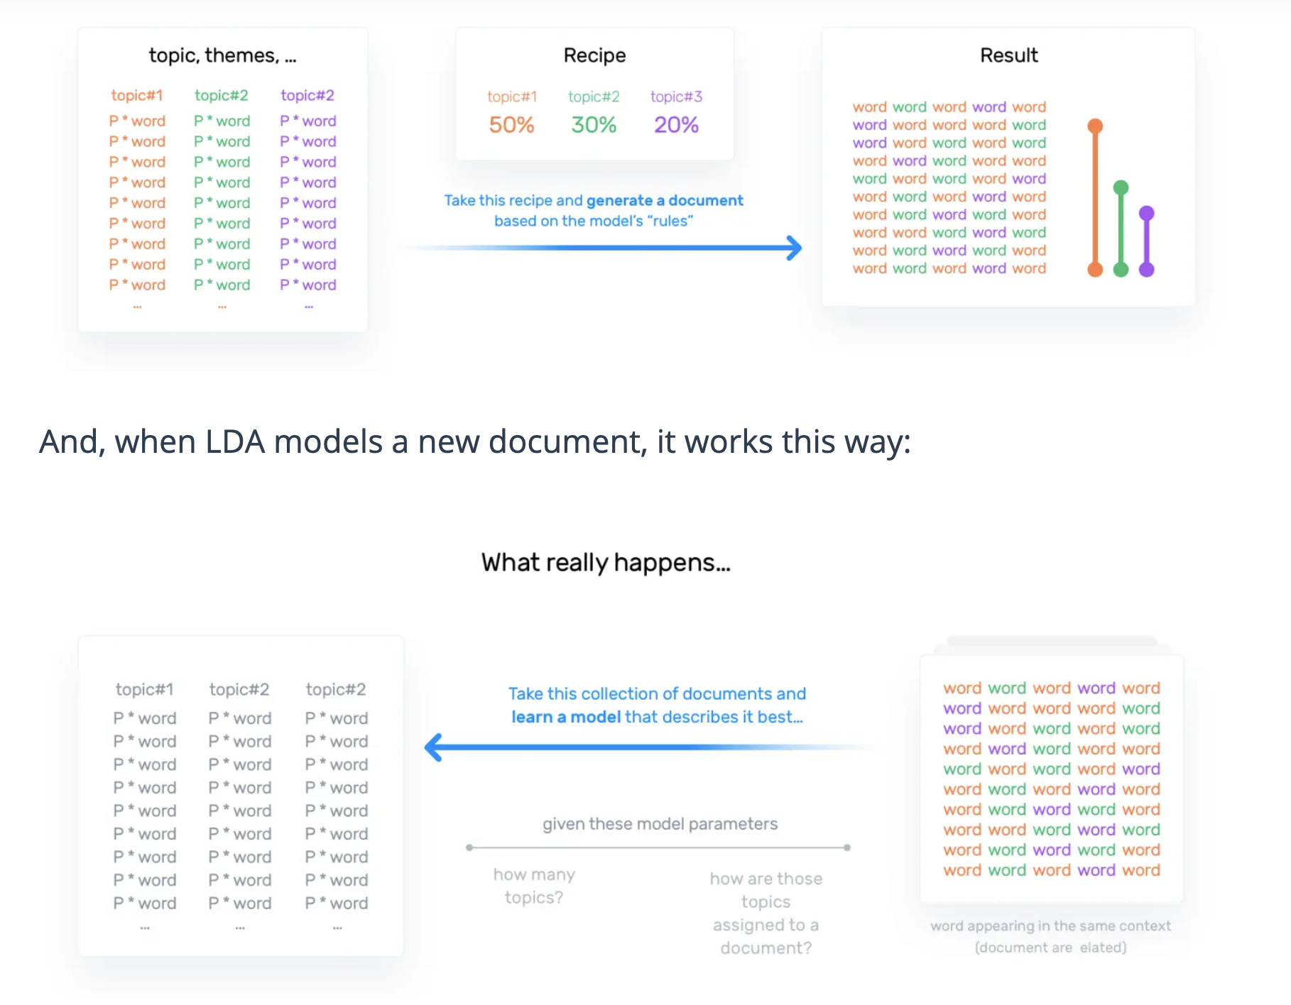

Slide 33
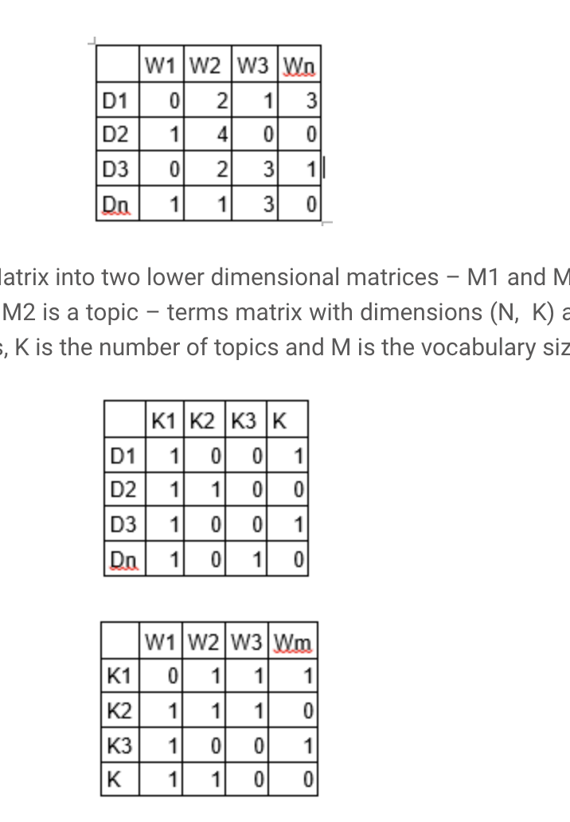
LDA is a matrix factorization technique. I
Document Representation - Vector space model - Document-term matrix
Initial - needs to be improved through iterations

Slide 34
Iterates through each word “w” for each document “d” and tries to adjust the current topic – word assignment with a new assignment.
A new topic “k” is assigned to word “w” with a probability P which is a product of two probabilities p1 and p2.
For every topic, two probabilities p1 and p2 are calculated
P1 – p(topic = t / document= d) = the proportion of words in document d that are currently assigned to topic t
P2 – p(word= w / topic = t) = the proportion of assignments to topic t over all documents that come from this word w.
The current topic – word assignment is updated with a new topic with the probability - which is equal to product of p1 and p2 - p (t/w) = p1*p2 - which denotes the probability that topic t generated word w
After a number of iterations, a steady state is achieved where the document topic and topic term distributions are fairly good.
This is the convergence point of LDA

Slide 35
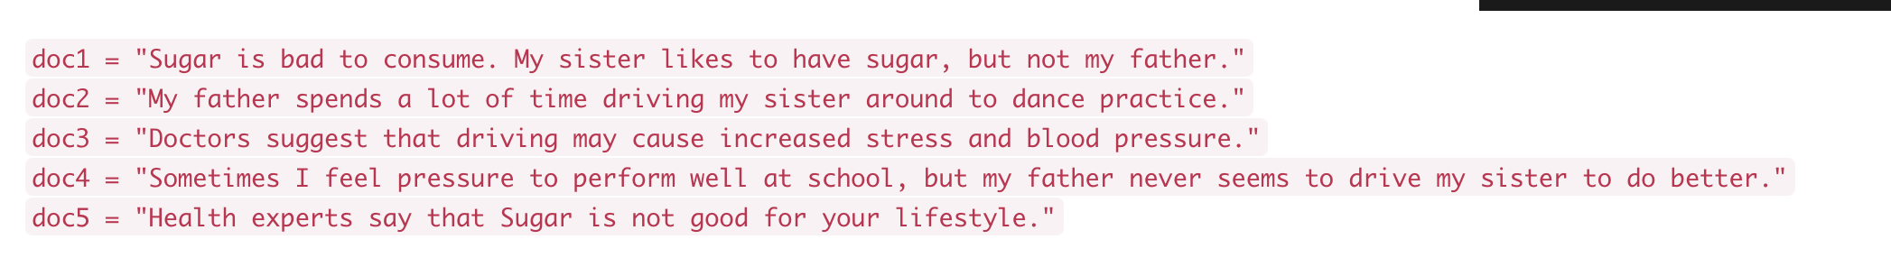
 | Topic - Food | Topic Health | Topic - Family | Topic - activity
Sugar | 0.8 | 0.2 | 0 | 0
Drive | 0 | 0 | 0.4 | 0.6
Pressure | 0 | 0.7 | 0.1 | 0.2
Sister | 0.1 | 0.1 | 0.6 | 0.2
 | Topic - Food | Topic Health | Topic - Family | Topic - activity
pressure
drive | 0 | 0 | 0.3 | 0.5
Sister | 0.2 | 0.2 | 0.6 | 0
P1
P(Food/d) = = 0.2*0.4 = 0.08
P(Health / d) = 0.2 *0.4 = 0.08
P(Family/d) = 0.3*(¼) + 0.6*⅘ = 0.8
P(activity) = 0.5*¼ + 0 = 0.15
P2
P(food/pressure) = 0
P(Health/pressure) = 0.7
P(Family / Pressure) = 0.1
P(Activity / Pressure) = 0.2
Food = 0
Health = 0.056
Family = 0.08
Activity = 0.03

Slide 36
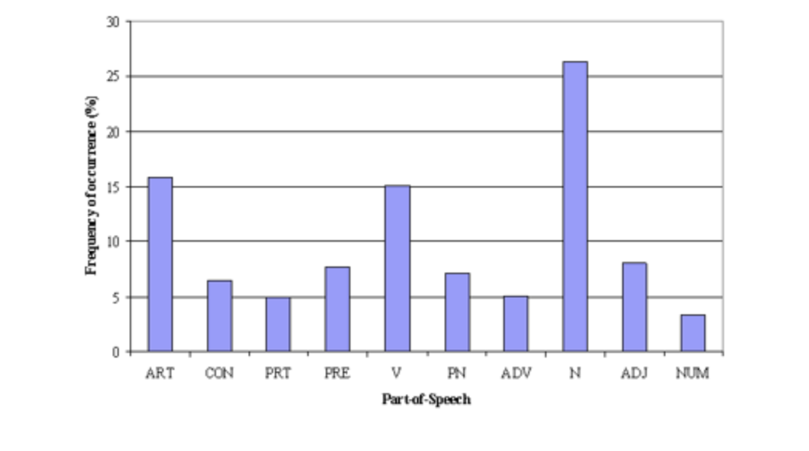
Analysis of POS tags
Tips - Words to include / exclude in Topic Modeling
Nouns and Verbs are important for this repository - could be function words - “not working”

Slide 37
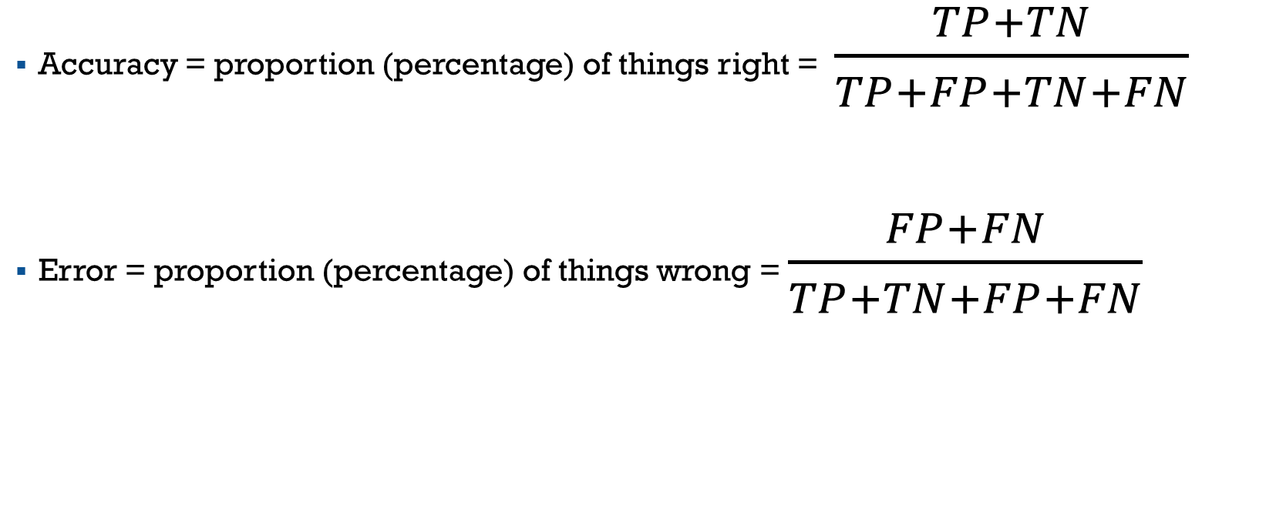
ACCURACY AS A MEASURE

Slide 38
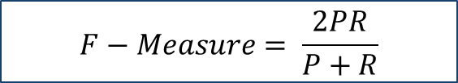
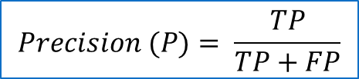
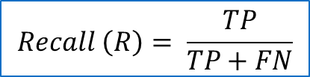
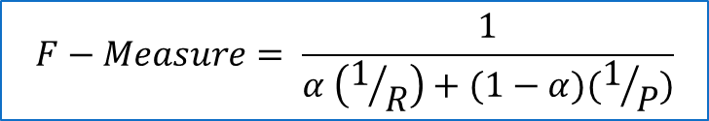
EVALUATION MEASURES FOR STATISTICAL NLP TASKS
Assume there exists a set of annotated elements
Words whose sense is disambiguated by humans
Target - to obtain same disambiguated label for each entry
 | Human Annotations for Label L
System Assigned Labels |  | L | ~L
 | L | TP | FP
 | ~L | FN | TN

Slide 39
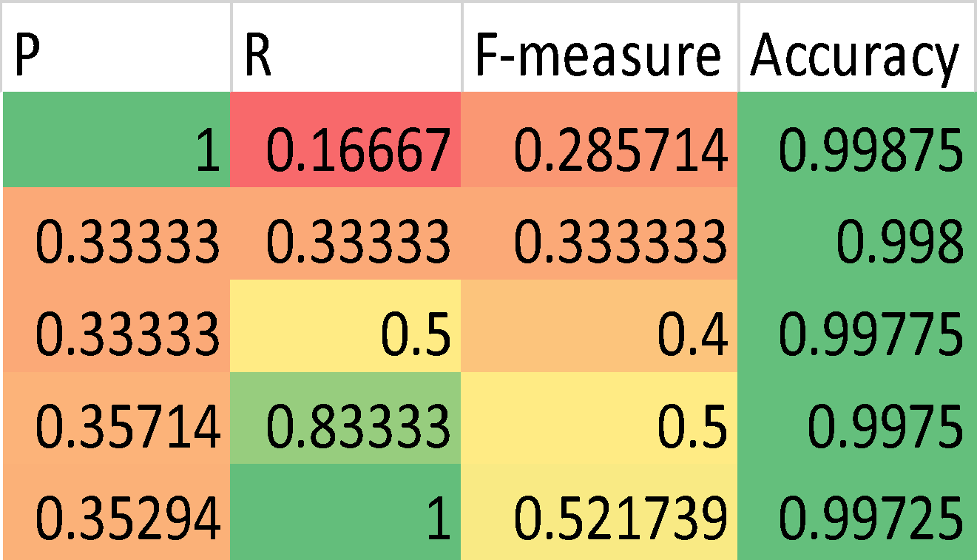
WORDS = 100,000 TARGET RELEVANT = 150
TP | FP | FN | TN
25 | 0 | 125 | 99850
50 | 100 | 100 | 99750
75 | 150 | 75 | 99700
125 | 225 | 25 | 99625
150 | 275 | 0 | 99575

Slide 40
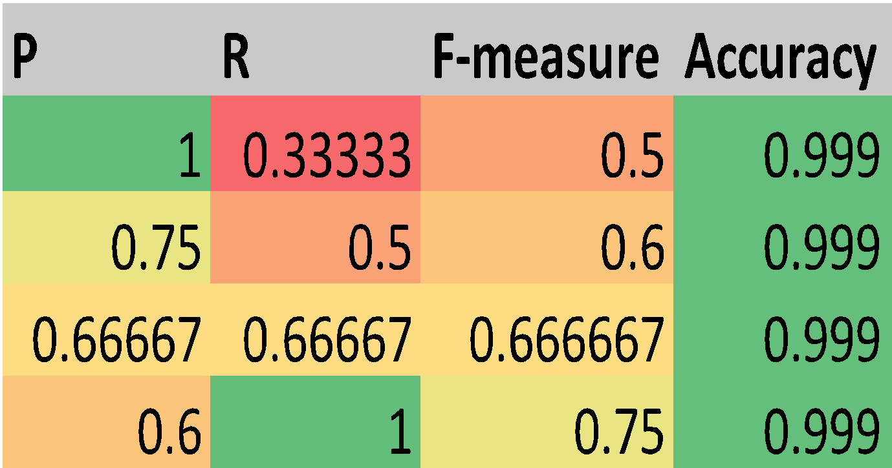
WORDS = 100,000 TARGET RELEVANT = 150
TP | FP | FN | TN
50 | 0 | 100 | 99850
75 | 25 | 75 | 99825
100 | 50 | 50 | 99800
150 | 100 | 0 | 99750

Slide 41
Summarize
Text Mining
Uses several properties of Text to solve practical problems
Text Classification
Assigns pre-defined labels to pieces of text
Learns word - label associations
Text Clustering
Groups similar texts together
Topic Extraction
Hidden concepts in text

Slide 42
LANGUAGE MODELS
Statistical Language Model

Slide 43
Language Models
Inspired by n-grams
Probability of all possible sequences of words
Probability of next word based on previous
● Inspired by
Speech recognition
Optical Character Recognition

Slide 44
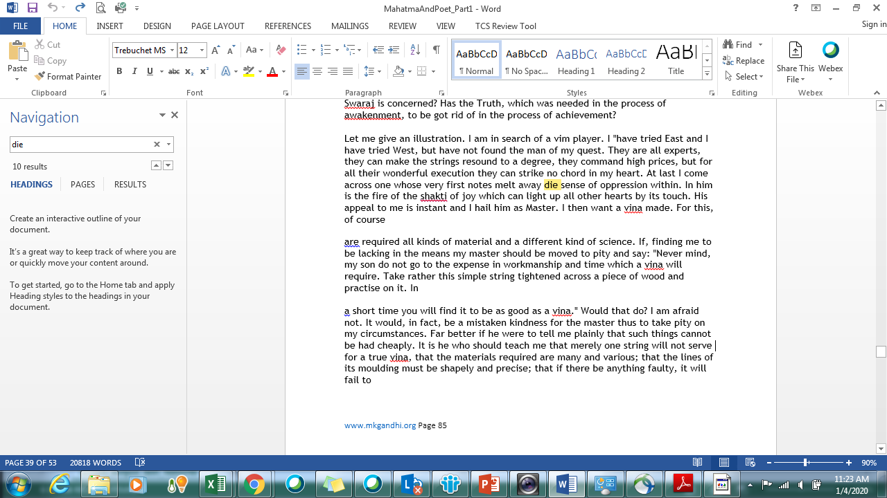
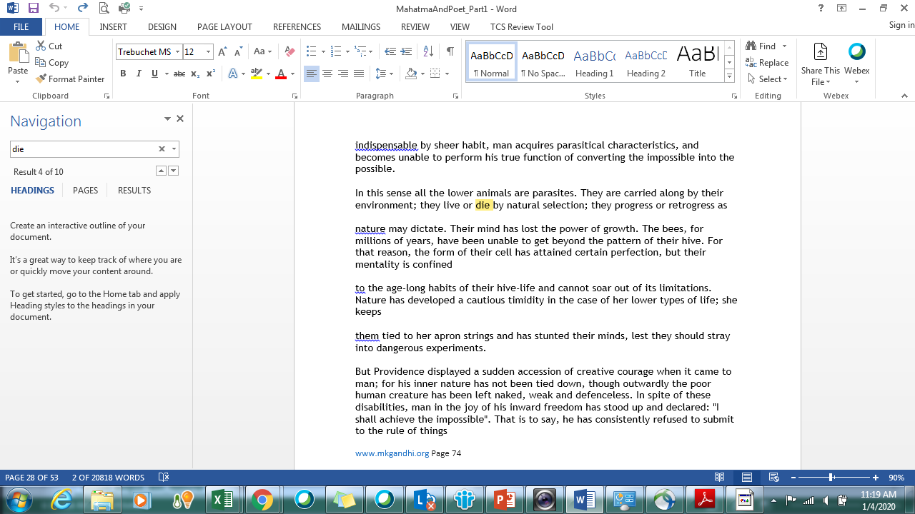
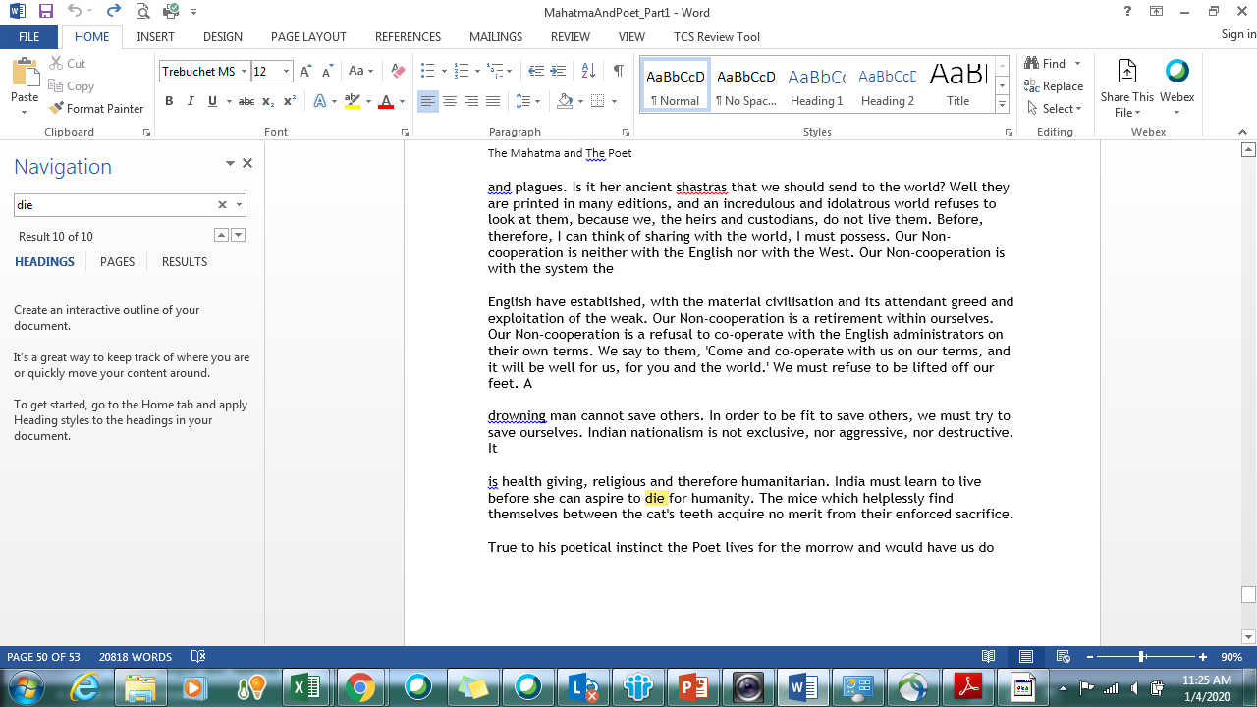
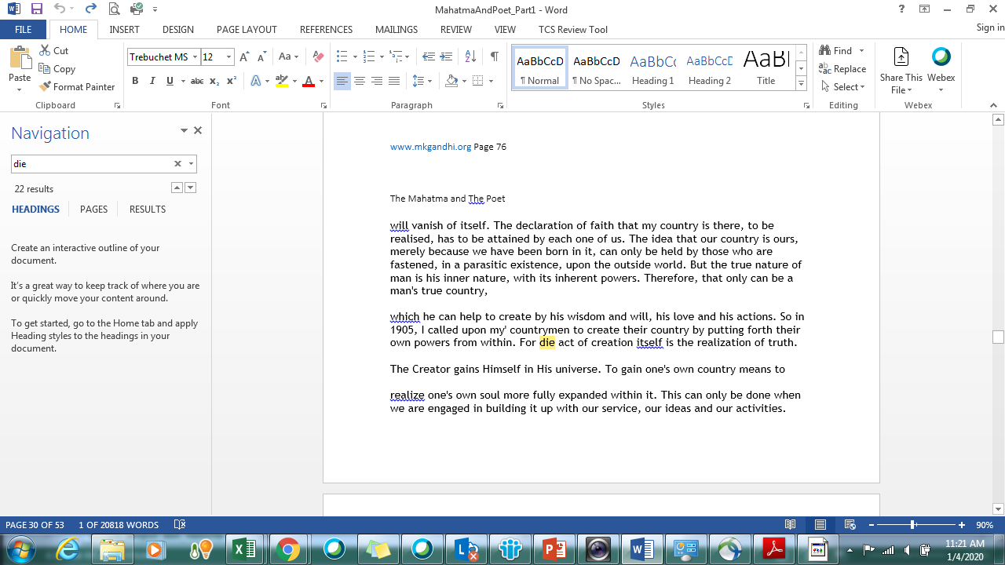
OCR output – Mahatma and the Poet

Slide 45
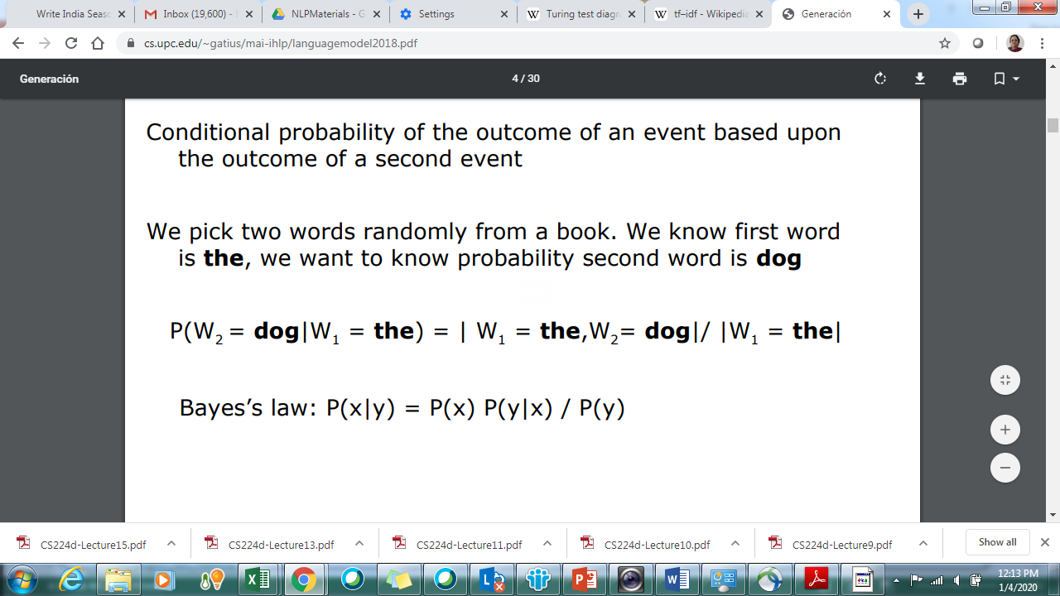
Conditional Probability

Slide 46
Statistical Model of a Language
Vocabulary (V)
Word w ∈ V
Language (L)
Sentence s ∈ L
L ⊂ V* usually infinite
s = w₁ ,…w_{N}
Probability of s =P(s)
Find P(S = W_{1,n}= <w_{1,n}>) where w_{1,n} is a sequence of words

Slide 47
Probability of a sequence
Compute probability of sequences - P(w₁ ,w₂ ,..,w_{n} )
Decompose using the chain rule of probability
P(w₁ ,w₂ ,..,w_{n} ) =P(w₁ )P(w₂ |w1 )P(w₃ |w₁ ,w₂),… P(w_{n} |w₁ ..,w_{n-1})
Markov assumption : we can predict the probability of some future unit without looking too far into the past

Slide 48
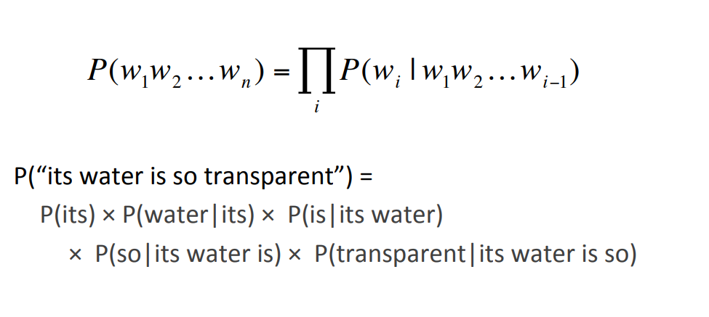
Example

Slide 49
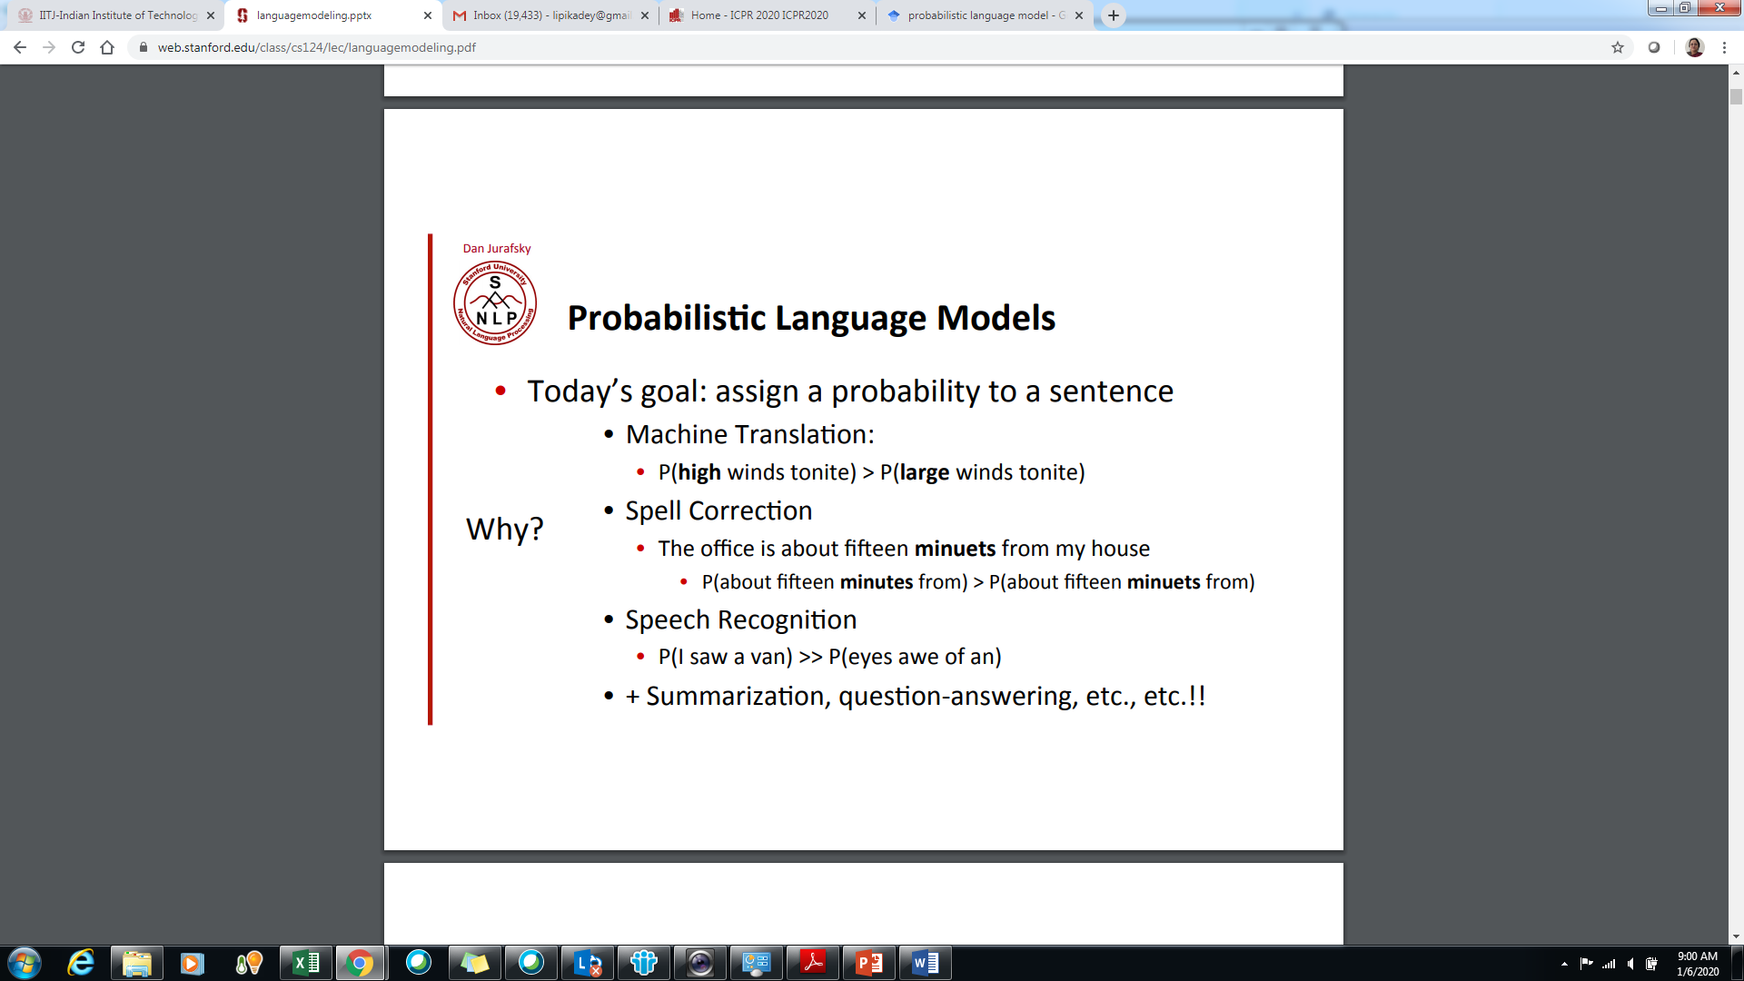
High probability sequences

Slide 50
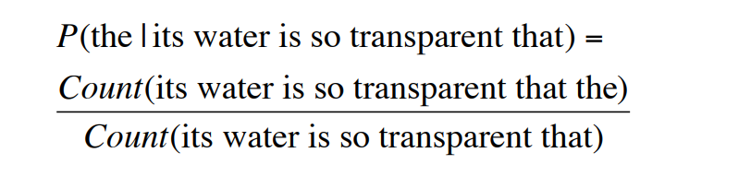
Estimating probabilities from corpus
Estimate from counts in corpus
P(w₁w₂…w_{n}) = Count_of (w₁w₂w₃…w_{n}) / Count_of (w₁w₂w₃…w_{n-1})
P(its water is so transparent that the) =
Impossible to get enough data

Slide 51
Predicting words to complete sequences
Given a sequence w₁w₂w₃…w_{n-1} – predicting next word w
Predicted word w = Maximum_Likelihood_EstimateP(w|w₁w₂w₃…w_{n-1})
Without enough data to compute probabilities – models are meaningless

Slide 52
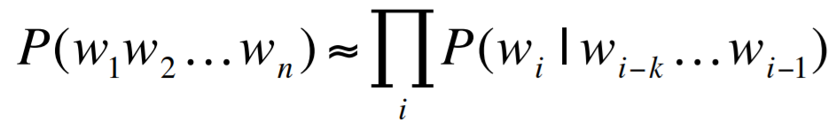
Ngram Models
Markovian Assumption – Not all n-1 previous words are required – limited data from the past can be used
Unigrams consider only one past word
P(w₁w₂w₃w₄) = P(w₂|w₁)*P(w₃|w₂)*P(w₄|w₃)
Bigrams consider only two past words
P(w₁w₂w₃w₄) = P(w₃ |w₁ w₂) * P(w₄|w₂w₃)
Trigrams consider only three past words
P(w₁w₂w₃w₄)= P(w₄ |w₁w₂w₃)

Slide 53
Experiment
Green –
Large Green –
I swallowed a large green –
Pro
The more information you have – the better is your prediction
Con
Sparseness of data - few words are common - vast majority of words are
very uncommon
Longer n-grams are rarer
MLE assigns a zero probability to unseen events.

Slide 54
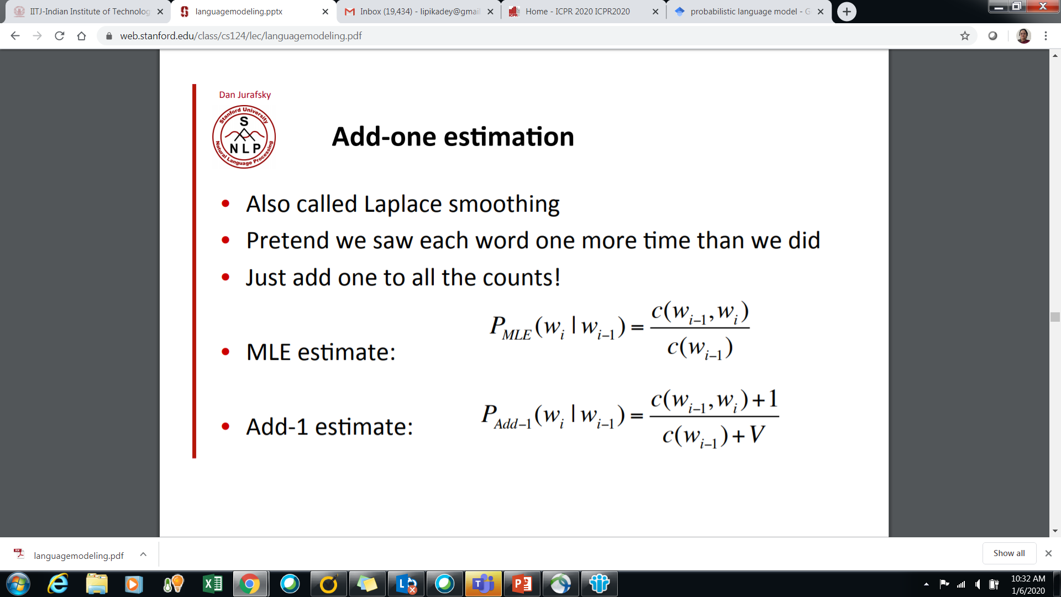
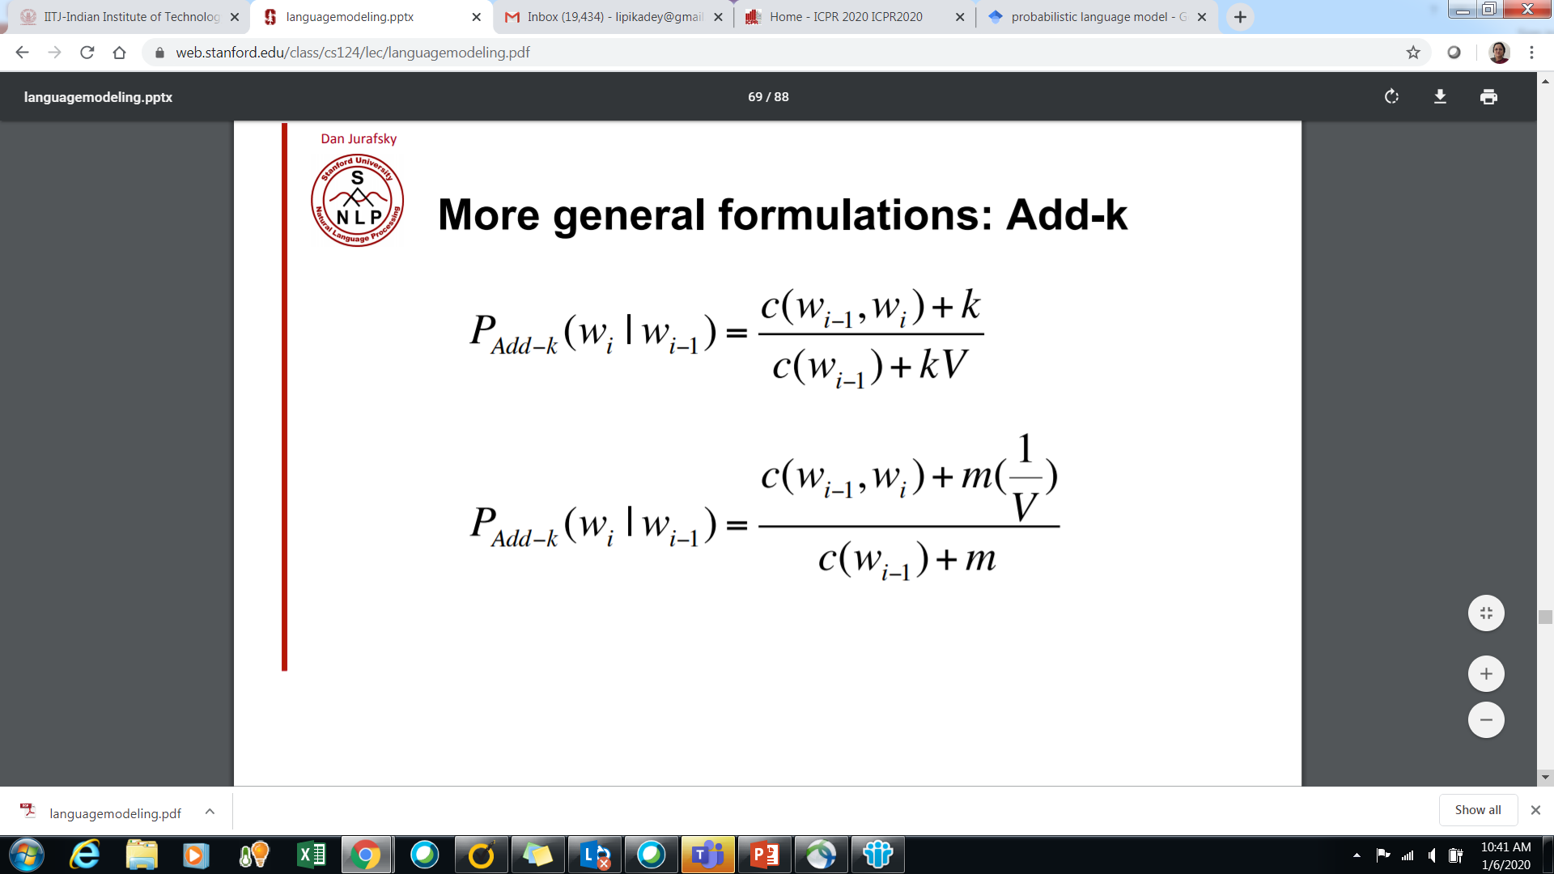
Laplacian smoothing

